Slide 1
EMS is ESSENTIAL

Slide 2
Tonight, we will use the healthcare SBAR method
to describe our approach to the
EMS Essential Service Process:
Situation: What is happening right now?
Background: What is the relevant background information?
Assessment: What do you think the problem is?
Recommendation: What do you suggest should be done?

Slide 3
First, What is Emergency Medical Services?
Emergency Medical Services (EMS) refers to a system that provides urgent medical care and transport to people who are seriously ill or injured. EMS is designed to quickly respond to emergencies, give life-saving care on the scene, and transport patients to hospitals if needed.

Slide 4
Situation: EMS is NOT required or guaranteed
Is that good enough for your family?

Slide 5
Service Providers need financial support –
Non-transport services (all fire-based):
Agency Fire & Rescue
Eldon Fire & Rescue
Ottumwa Fire & Rescue
Wapello County Rural Fire & Rescue
Non-transport services (independent):
Hedrick QRS
Transport services:
Blakesburg Fire & Rescue
Ottumwa Regional Mobile Intensive Care Services (ORMICS)
Fire department only response for cardiac and trauma:
Eddyville Fire
Law Enforcement response for cardiac and trauma:
Ottumwa Police Department
Wapello County Sheriff’s Office
Fire-based services are using funds intended for fire protection, which is inadequate
Transport services are billing patients which in our county 78% are on government programs which do not fully reimburse costs.

Slide 6
Families need a guaranteed service for emergency care and transport as part of their healthcare options
Communities need a contract with Measureable Outcomes (data) and Accountability (enforceable terms)
1986 was the last year of any agreement and public support of the ambulance service
The goal is to ensure a community system that serves each of our families and the communities we are a part of that meets our needs, is sustainable and reliable.

Slide 7
Iowa System Standards establishes metrics that are ideal goals for setting expectations for an EMS system to meet to have a quality system. This is what every Iowan may expect from EMS.
Section 1 System Organization & Management
Section 2 Staffing and Training
Section 3 Communications
Section 4 Response & Transportation
Section 5 Facilities/Critical Care
Section 6 Data Collection/System Evaluation
Section 7 Public Information & Education
Section 8 Disaster Medical Response

Slide 8
Iowa Code Chapter 422D gives Counties the ability to:
1. Establish an Advisory Council of local experts to study the data and design a quality system
2. Ask the taxpayers for a levy to support that quality system

Slide 9
Interactive break!
Have you ever called 911?

Slide 10
Background: a quick look at the evolution of EMS in Wapello County:

Slide 11
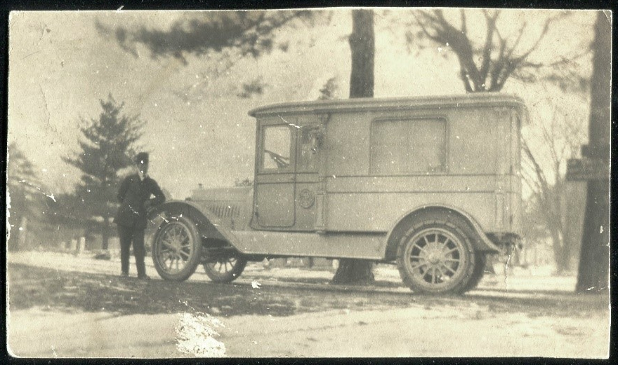
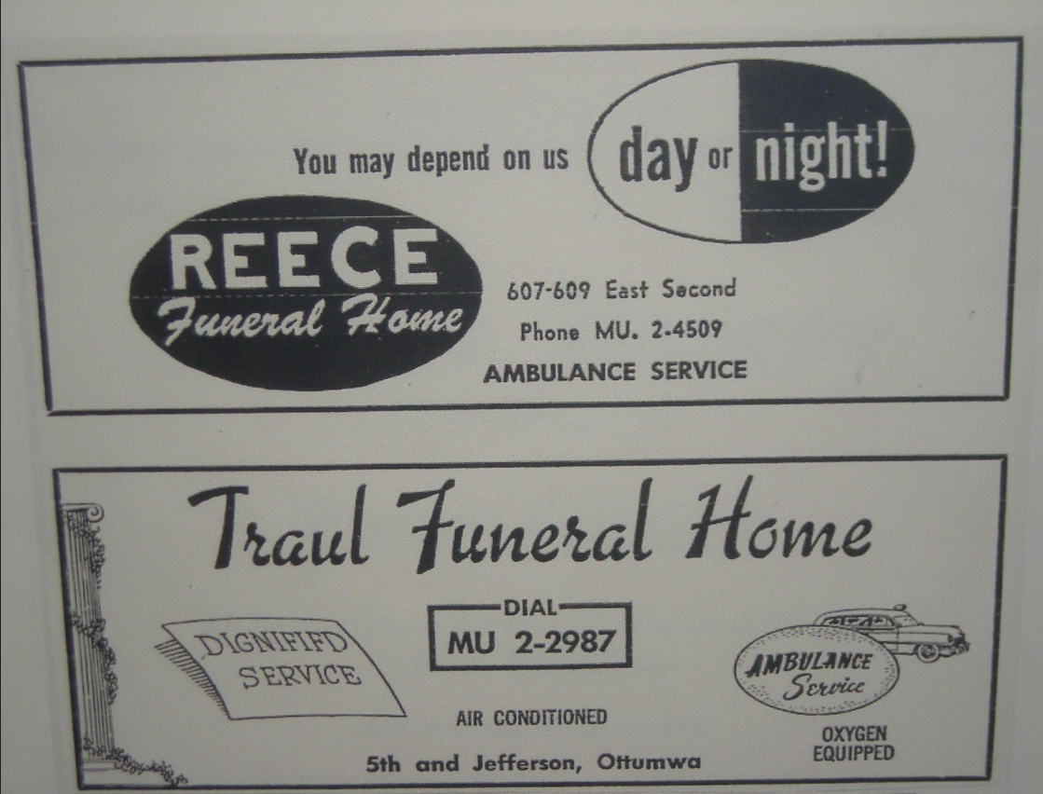
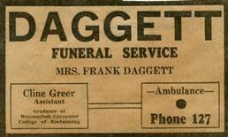
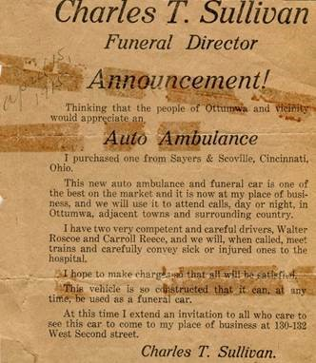
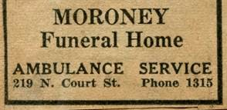
1940’s
Funeral homes provide transport as a service.
1942 “Defense Ambulance Fund” fundraiser. Goal to raise $1200 for purchase of an ambulance by the Civil Defense Committee.

Slide 12
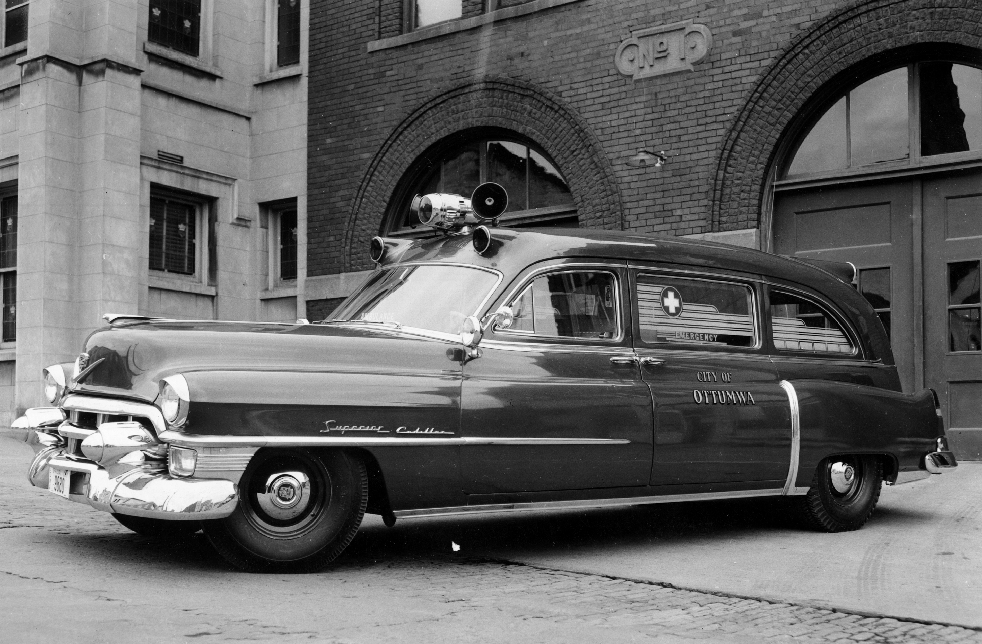
1950’s
1952: Ottumwa Fire Department begins 24-hour ambulance service. Ambulance provided by public donations and there was no fee for service.

Slide 13
1950’s
1953 Fire department questions the need of buying an ambulance. Four firemen laid off. Discussion on raising money with subscriptions.
1953 Money made available to purchase new ambulance. Money comes from public safety and $1200 in donations from Willing Circle of King’s Daughters.
Subscriptions not successful.
1955 New ambulance in service for one month involved in crash, taken out of service. Reliance on private services.

Slide 14
1960’s
1966: President Johnson receives report “Accidental Death and Disability: The Neglected Disease of Modern Society”, later known as the “EMS White Paper”. Report revealed in 1965 alone, vehicle accidents killed more Americans than were lost in the Korean War. This led to standardization of emergency training which led to the first nationally recognized curriculum for EMS- emergency medical technician-ambulance (EMT-A). Many consider this document the birth of modern EMS.
1967 Ottumwa Fire discovers it’s expensive to run an ambulance service. Fire Chief Smith wants rid of responsibility of ambulance.
City at max levy.
Ambulance fee study. U of I Bureau of Police Science studying a state of crisis in emergency ambulance service. Many towns and cities police and fire picking up service because many funeral homes in Iowa are ceasing service due to new federal minimum wage for drivers.

Slide 15
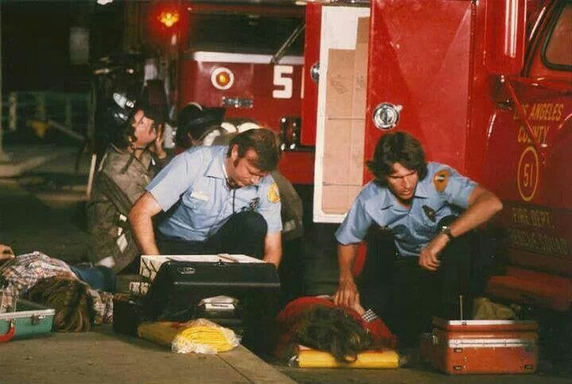
1970’s
1970 California Governor Ronald Reagan signed into law the Wedworth-Townsend Paramedic Act. This law created conditions for the establishment of the first accredited paramedic training program in the U.S.
1972 TV series “Emergency” aired which mirrored the LA County Fire’s paramedic program. This show portrayed paramedics providing care never seen before to the nation. Johnny and Roy set a standard expectation for the public and inspired many people to become providers that work in EMS today.

Slide 16
1970’s
1973 Funeral homes cease to provide ambulance service. Four local funeral homes informed County Supervisors they would cease ambulance service on December 31st at midnight. Funeral homes had been handling transfers from nursing homes to hospital.
EMS Systems Act of 1973 established NHTSA (under DOT) as lead agency to develop EMS systems and provided funding for 300 systems nationwide. NHTSA encouraged state level involvement in developing trauma systems.

Slide 17
Interactive break!
Have you ever ridden in an ambulance?

Slide 18
1970’s
1974 Ottumwa looks for ways to improve ambulance service. Ottumwa has one emergency unit based in the fire department and two non-emergency units based in health dept. No emergency service is provided to surrounding communities or rural.
New Ambulance plan: Ottumwa Fire Department will operate an emergency ambulance only within the city limits and a section of highway outside Ottumwa. If the fire department is busy, the police department must respond with the ambulance.
The city will no longer provide non-emergency service and will give an ambulance to the hospital for that service. City personnel will drive transfers, which will be attended by hospital personnel.
Eldon Area Ambulance Service fundraises for an ambulance.
County takes over ambulance service from fire department.

Slide 19
1970’s
Wapello County Ambulance Service began operations June 24, 1974. Prior to that date, the service provided only non-emergent transport services in the county. The new service will respond to all calls anywhere in the county. Federal Revenue Sharing funds were tapped to start the service.
A new ambulance pact between the city and county states that the city will make its ambulance at Central Fire available for emergency service in the county if the three city-county ambulances are tied up.
Discussions under way with surrounding towns for back-up service.
Should the ambulance show a loss, the city and county would share in making up the deficit.
Neither city or county has a capital replacement fund. Current ambulances do not have heat or air conditioning.

Slide 20
1970’s
1975 Need for a new technologically modern ambulance. Struggles with ambulances breaking down and no funds to replace. New ambulances cost $17,500. Appeal to the public for fundraising.
Fundraiser successful for purchase of new ambulance.
1978 Ambulance breaks down while transporting patient to Iowa City. Service director reports issues with constant repairs. Cost of new ambulance between $20,000 - $24,000.
City and County contribute one quarter of service’s annual budget which was $170,000 for FY78.
1979 County Supervisors discuss moving administrative jurisdiction to city since they have most of the calls. Costs are currently shared 50-50
Ambulance service losing money. City accuses County of trying to dump ambulance service to city.
Ambulance service receives $75,000 from local subsidy.

Slide 21
1980’s
1980:
Headline: “County wants out of ambulance service”. Ambulance service offered to the two hospitals by county. Ottumwa Hospital would consider both joint and single ownership. Hospital Administrator said “We have a deep commitment to emergency services”. Ambulance fee is $65 per run. Medicare and Medicaid pays 80% of allowable charges- $45 for emergency and $40 for non-emergency.
Ambulance funding a problem. City and County contributions increase from $48,000 to $90,000.
State legislation passed bill that takes effect Jan. 1981 allowing counties to vote on an EMS levy for .27 cents per thousand.
New ambulance tax levy question discussed. New tax could generate $96,000. County has been relying on federal revenue sharing funds to support ambulance.
Supervisors place tax levy on November ballot. Ambulance tax levy fails at the polls by 119 votes. (so does the hotel-motel tax).
Ambulance fate may be up to Congress. The US Congress deciding if they will continue the federal revenue sharing program. The county receives $341,000 from this program which their $90,000 share comes from.
St. Joseph and Ottumwa Hospital work out a plan to move ambulance management to Ottumwa Hospital.

Slide 22
1980’s
1981:
The county surrenders ownership rights and authority to the city so the city can negotiate with the hospital to take over the service. The county still agrees to help purchase new ambulances needed by the hospital. The ambulances will be owned by the city and leased to the hospital.
The county gets out of the ambulance business and officially blesses Ottumwa Hospital’s plan to provide ambulance service. Supervisors terminate their 7-year agreement with the city and sell Wapello County ambulances to the city for $1. The county agrees to pay half the cost of three new ambulances.
Ottumwa Hospital asks for a three-year agreement with the city and county to subsidize operations totaling $152,000 for the purchase of ambulances. Ottumwa Hospital’s offer to take over operations includes upgrading the service to paramedic level.

Slide 23
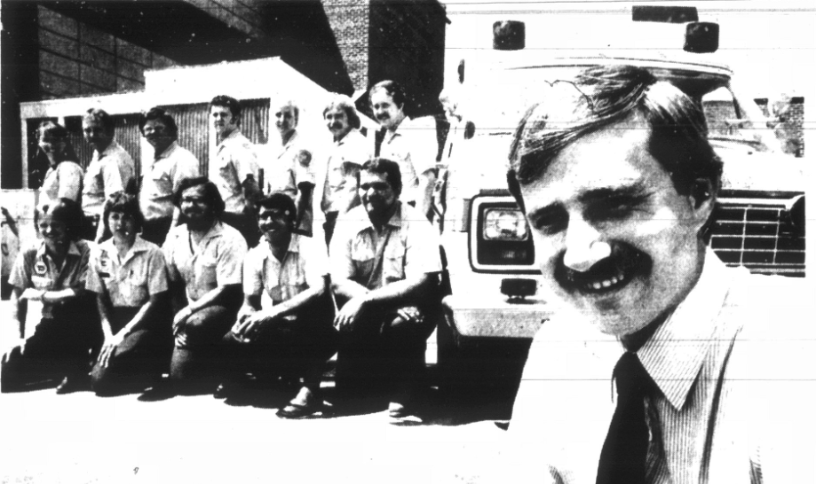
1980’s
Ottumwa Regional Mobile Intensive Care Services (ORMICS) begins county-wide service July 1, 1981

Slide 24
1980’s
1984
ORMICS requests that the city and county continue subsidies. It asks for $33,250 each, based on equipment replacement costs. The tax discussion continues.
Wapello County Supervisors committed to a $99,000 subsidy over the next three years. This leaves a deficit of $20,000. City of Ottumwa said they can provide no funds. Rate structures will be revised to make up the deficit.

Slide 25
Interactive break!
Who wants the best team giving top notch care using the best technology?

Slide 26
1980’s
1984 Agency CPR Association formed, later becomes Agency First Responders
1985 ORMICS needs $23,000 to replace a worn out ambulance.
The county will give the ambulance service $30,000 this year and $33,000 and $36,000 the next two years. Ambulance board members encouraged City of Ottumwa to pay their “fair share”. Council approved a “token” amount of $3,000.
President Reagan wants to eliminate the Federal Revenue Sharing program which Wapello County uses to subsidize ORMICS. The county committed to $33,000 for FY86 and $36,000 for FY87.
1987 Federal Revenue Sharing funds ends that allowed subsidies which went for equipment.
1988 The Wapello County Emergency Medical Services Association is formed to promote EMS, be a channel of communication between local providers and governmental and business, organizations and groups concerned with the delivery of emergency medical care, to promote EMS education, to promote a high ethical standard for EMS, to select projects funded by various grants and other funding.

Slide 27
1990’s
1994 ORMICS is named Paramedic Service of the Year by the Iowa EMS Association and National Paramedic Service of the Year by the National Association of EMTs.
1995 Chillicothe First Responders formed to serve Cass & Richland Townships, Cities of Chillicothe & Kirkville.
1998 Ottumwa Regional Health Foundation dedicates a new ambulance with proceeds from Great Southeast Iowa Duck Race and Swift water Festival. An old ORMICS ambulance is given to the Eldon community.

Slide 28
2000’s
2000 ORMICS fund raiser (Duck Race). ORMICS receives no funding from city, county or tax levy. ORMICS has staff of 24 paramedics. Fundraiser to help purchase a new ambulance that costs $86,668.
2002 Ottumwa Fire Department raising money to buy defibrillators and other equipment to be “compatible” with ORMICS.
20 Ottumwa Fire Fighters training to become medical first responders to assist ORMICS. Buying 3 defibrillators. Ottumwa Fire to focus their first responder program on south side of Ottumwa.
2003 Wapello County EMS Assn. working on training opportunities, push for EMD and seeking to work with 911 Board, working on a community trauma education program, Assn. seeks greater community involvement in EMS.

Slide 29
2000’s
2005 Eddyville Fire Department dropping ambulance service.
2009 Eldon ambulance ends transport service.
2010 State of Iowa develops “EMS System Standards” and provides a scoring rubric to local partners.
Ottumwa Regional Health Center sells to RegionalCare, a for-profit company.
2012 Wapello County EMS Association conducts public meeting of stakeholders to review System Standards.
2019 Wapello County Public Health decertifies Medicare/Medicaid, no longer provides in-home services.

Slide 30
Interactive break!
What has saved a life?

Slide 31
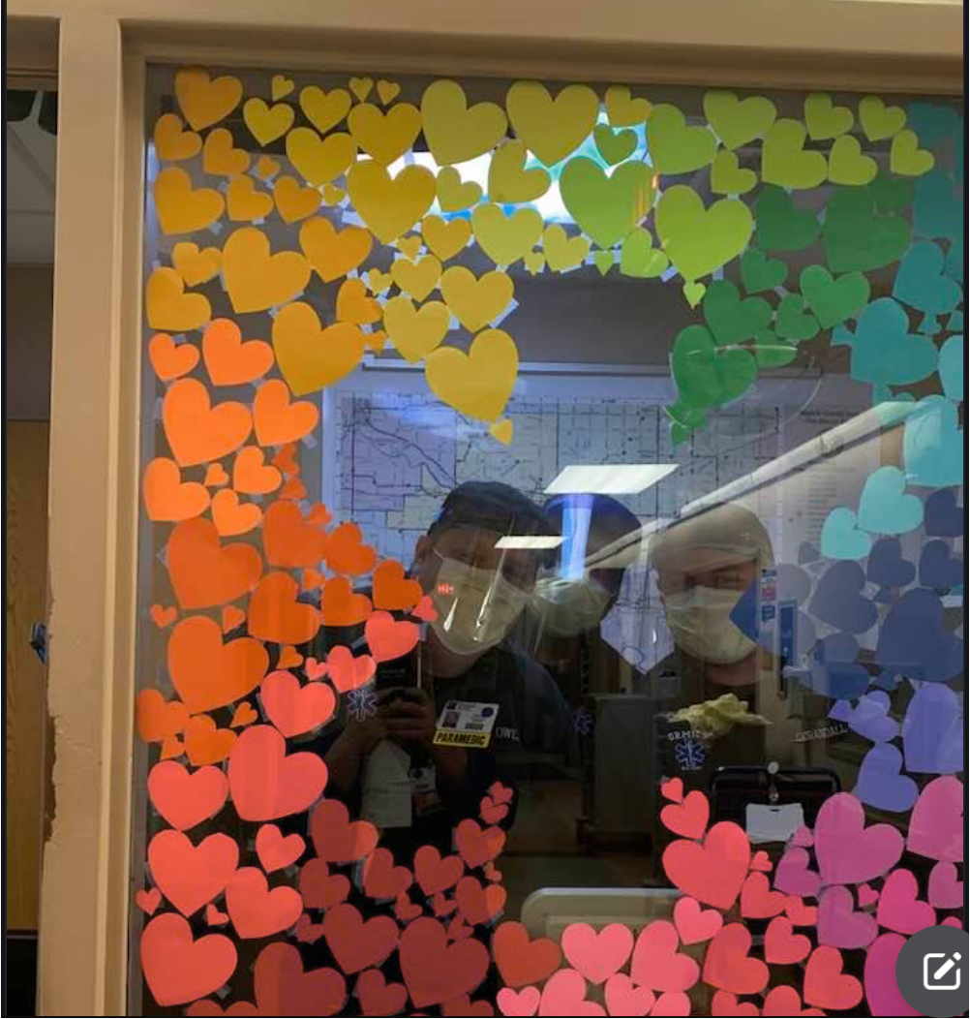
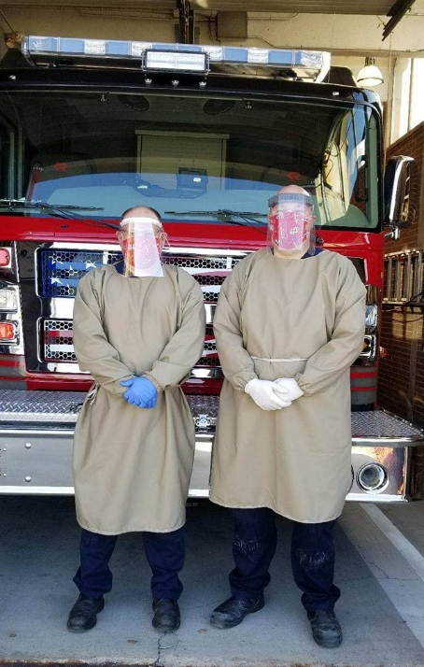
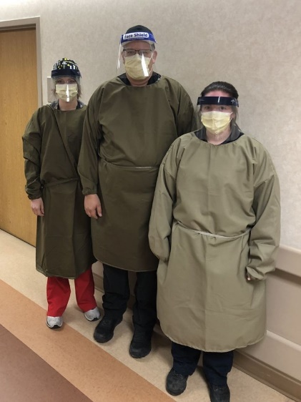
2020 Worldwide COVID-19 pandemic. The “Great Resignation” occurs. Both dramatically affect workforces across all sectors, healthcare is especially hit hard.

Slide 32
2000’s
2022
IHCC EMS Advisory Committee looking at very low enrollment numbers 3-EMT and 4-paramedic, discusses the need to do more outreach to recruit students. Group discussed a group effort to boost numbers.
Wapello County EMS Association revisits System Standards, provides data to Service Area 5 Healthcare Coalition as required by the State. Becomes annual requirement with state in Service Area 5 with goals and action plans.
IHCC EMS Advisory Committee discusses how to get EMS education into the high schools are early recruitment. Sub-committee formed to look into ways to do this.
Ottumwa Regional asks local officials for financial assistance to shore up EMS services. Both staffing and equipment needs cited.
Discussions between hospital and city and county officials about support. No definitive actions taken.

Slide 33
2000’s
2023
Letter to the community from CEO William Kiefer co-signed by community leaders explaining moving ORMICS from full paramedic authorization to conditional authorization. Letter explained why that was necessary and what it means.
Wapello Co. EMA in partnership with Van Buren County Hospital, Davis County Hospital, Centerville Fire & Rescue and Indian Hills Community College launch a 4-county partnership for a summer youth EMT internship program with a Future Ready Iowa Grant. This initiative seeks to get youth interested in EMS careers and help fill staffing gaps.
IHCC EMS Advisory Committee recommends changes to the EMS program: eliminate degree requirement to speed up completion time for paramedics. EMS Advisory met with college administration to discuss concerns regarding the program and express commitment to support. Program moved to non-credit programs removing many of the common barriers for students that exist in the credit program. This makes the program shorter and more affordable.
EMA presents EMS as Essential Service Resolution to Board of Supervisors on behalf of the Wapello County EMS Association representing all EMS services. Resolution supported but fails to move forward due to other competing priorities.

Slide 34
2000’s
2024
Indian Hills Community College in partnership with the original planning team repeats the summer youth EMT internship program with grant funding. Planners are hopeful this will be a sustainable project and a constant feeder into the paramedic program.
Board of Supervisors revisit topic of EMS.
EMA presents EMS Essential Service process to Board of Supervisors, meets with local officials and stakeholders.
Wapello County EMS Association reviews draft Advisory Council list as recommendation to Board of Supervisors.
EMA to take lead on Essential Service work, coordinating the next steps.

Slide 35
Interactive break!
What is the value of a human life?

Slide 36
Assessment is the task of the Advisory Council:
In collaboration and cooperation with the Wapello County EMS Association, the Advisory Council shall survey, analyze, and report on the performance of the following segments of EMS in Wapello County:
Access to quality EMS by evaluating the structure, process, and outcome of EMS events.
Adequacy of system funding.
Appropriate resource utilization.
Reduction of the burden on the volunteer EMS providers.
Integration of EMS into the existing healthcare system.
Continuing Education and training to meet certification requirements are offered.

Slide 37
What is our community asking of EMS?

Slide 38
What are some of our current system gaps according to the system standards?
Section 1 System Organization & Management
We do not have a true county-wide system which creates lack of consistency and quality, duplicates efforts, and is not cost efficient.
Section 2 Staffing and Training
Primary transport agency struggles to keep full-time lines filled and periodically does not have enough staff to have an adequate number of crews
Profession-wide issue of recruiting new talent into the career. Average career length is 5 years. Often a starting point to a healthcare continuum career.
Section 3 Communications
911 centers do not offer any sort of caller assistance such as CPR-T or EMD.

Slide 39
Section 4 Response & Transportation
Ambulance fleet is in need of upgrade. High mileage units are in use and are a cost burden.
Section 5 Facilities/Critical Care
Section 6 Data Collection/System Evaluation
Consistent data collection processes are not being utilized causing disagreement on data points. Consistent data is the base for making good system decisions.
Section 7 Public Information & Education
System performance is not reported to the public
Section 8 Disaster Medical Response
Our system gaps leaves us vulnerable to adequately responding to surge needs

Slide 40
What does EMS cost?
Equipment & Personnel (age-old problems, as the historical timeline points out)

Slide 41
Our county’s payer mix

Slide 42
Interactive break!
Have you ever been in a car accident?

Slide 43
Recommendations: to the Board of Supervisors is the result of the Essential Service Process:
Board of Supervisors recognize need and discuss (Jan 14)
Resolution introduced (Jan 28) and approved for publication of 60-day notice (Feb 1)
Resolution read three times (Apr 8, Apr 22, May 6)
Advisory Council appointed (May 6)
Advisory Council studies issues and develops recommendations (Summer 2025)
Advisory Council presents recommendations to Board of Supervisors (Fall 2025)
Proposal may be presented to the voters by the Board of Supervisors (TBD)

Slide 44
For more information:
A website will be published soon with all of the EMS background information that is part of our county’s EMS Essential Service work at
www.wapelloready.org/ems
Questions are welcomed and encouraged.
Thank You to all our speakers this evening!

